Slide 1


ONLINE LIBRARY SYSTEM By B Anuraag : 160120737147 D V Dheeraj : 160120737148

Slide 2
INTRODUCTION
This project on Online Library focuses on the computerized storage of books in the form of eBooks.
The website interface provides the Administrator an easy and efficient tools to add, edit and delete eBooks.
Allow Readers to Access and Download eBooks on Demand.
Readers can find resources instantly as books are segregated department wise.

Slide 3

Motivation
In the present day with the pandemic being deadly, it is being very difficult for people to access materials, especially books.
Everyone wish to have access to each and every book without any restrictions.
An Online Library would solve all the problems hence giving lifetime access to every book and it would provide a safe experience for the user.

Slide 4

Problem Statement
To get a book issued from a conventional library is a tiresome process where the reader need to search for the book manually and provide his ID to get the book issued.
The Books issued need to be returned within specified time limit to avoid fine and users are not allowed to issue more than 3 books at a time.
No full-time access to libraries.
Updating of old books is time taking process.

Slide 5
OBJECTIVE OF THE PROJECT
Multiple and Simultaneous Access
Eliminate Deterioration of Resources
Preserve Knowledge for the Future Generation
Replace the Conventional Libraries.
Life-time access to books.
Make a Wide Variety of Content Access

Slide 6
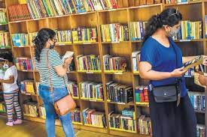

Existing System vs Proposed System
Issuing of a books is a time taking process.
Updating of books is not so easy.
Its tedious task to Add a new book.
Access to books is limited.
The book can easily be downloaded on user demand.
Updating of books is really quick.
Adding a new book or Deleting a book is much easier now.
Life-time Access to Books.

Slide 7

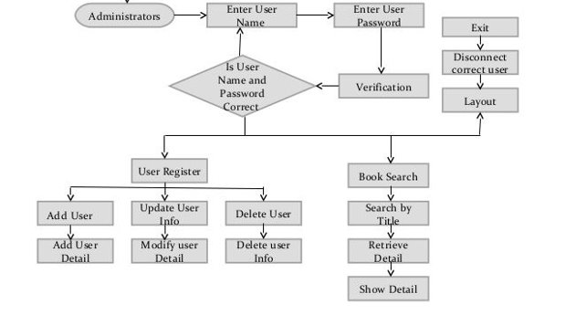



DESIGN & FLOW CHART

Slide 8

IMPLEMENTATION
Front End
Html: HTML code is used to design how a browser displays web page elements, such as text, hyperlinks, and media files. Simply putting into words, it represents a structure of the web page.
CSS : Cascading style sheets is used to style and layout webpages. In our website we used CSS for styling purposes like font alignment, styling, size and spacing.
Bootstrap : Bootstrap is a CSS framework which is used for developing a responsive webpage. In our project, we used bootstrap as in-built templates of html and CSS.

Slide 9
IMPLEMENTATION
Back-End
In back end we used MySQL and PHP
PHP is a server-side scripting language which is embedded in HTML. It is used to manage dynamic content, establish database connection and even session tracking.
In our project PHP was used as the backend language. A backend connection is set up by connecting the file with MySQL Database.
SMTP is used in sending OTP for user verification
MySQL : It is an open-source database used by developers to build web pages. In our project we used MySQL for the databases to maintain user registrations and eBooks of our Online Library.
XAMPP
XAMPP server is used to host the website on local system.

Slide 10
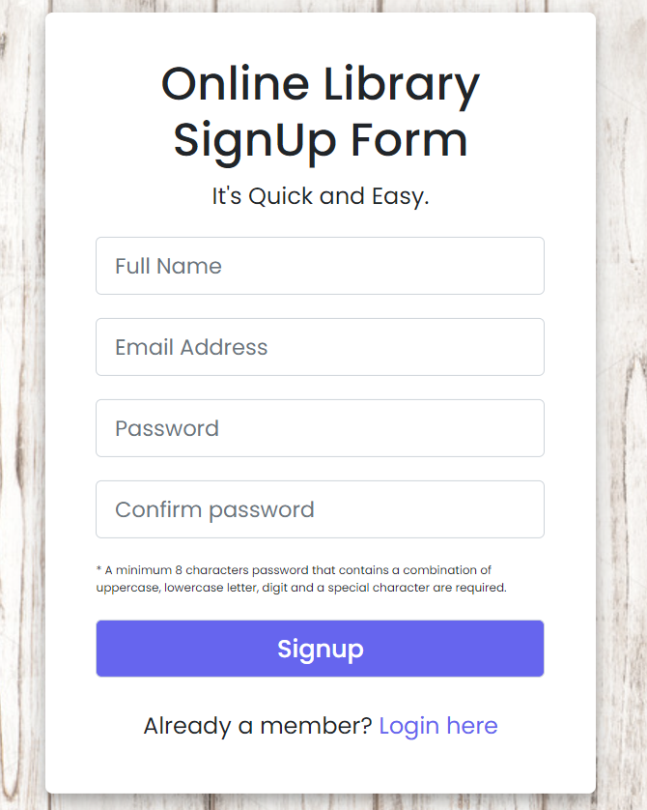
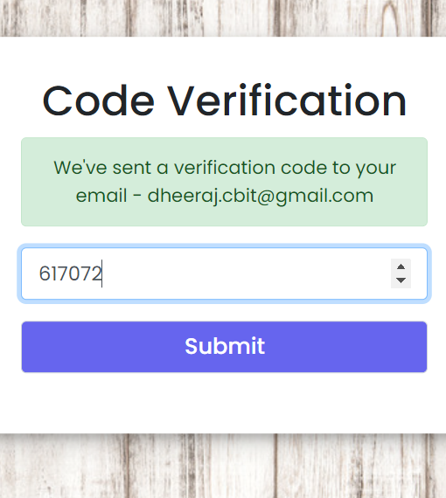
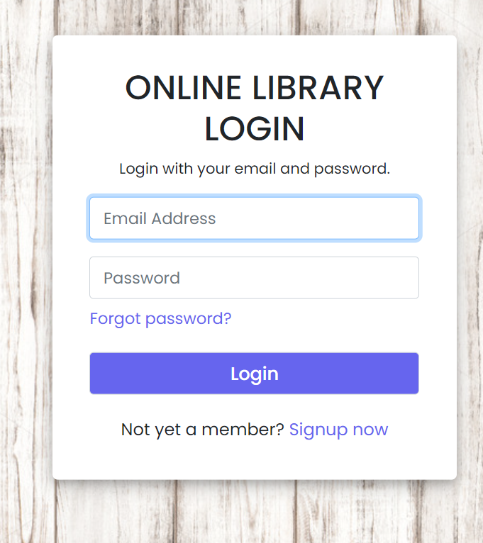
RESULTS

Slide 11
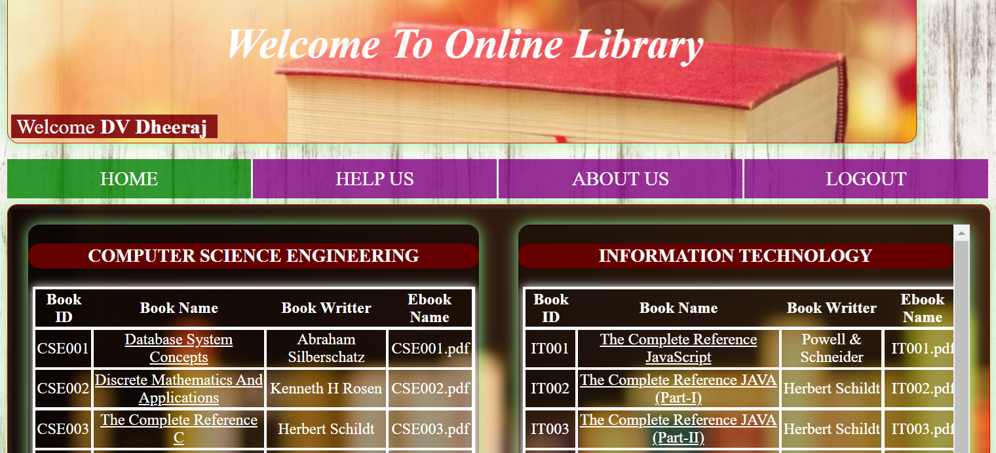
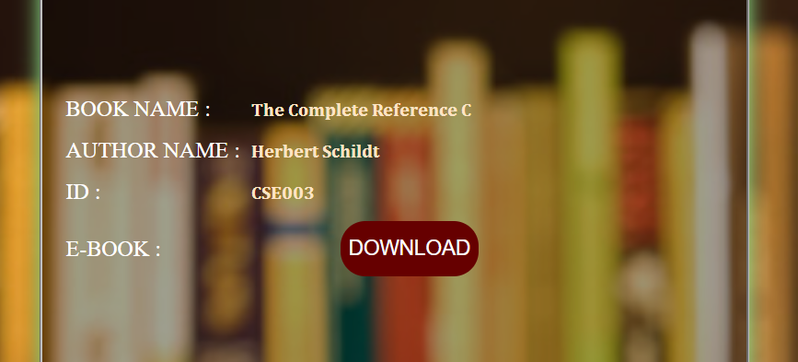
RESULTS

Slide 12
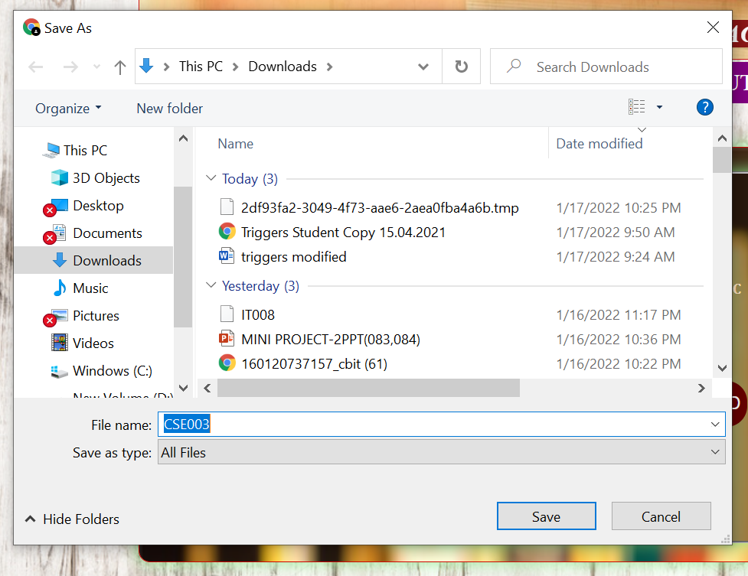
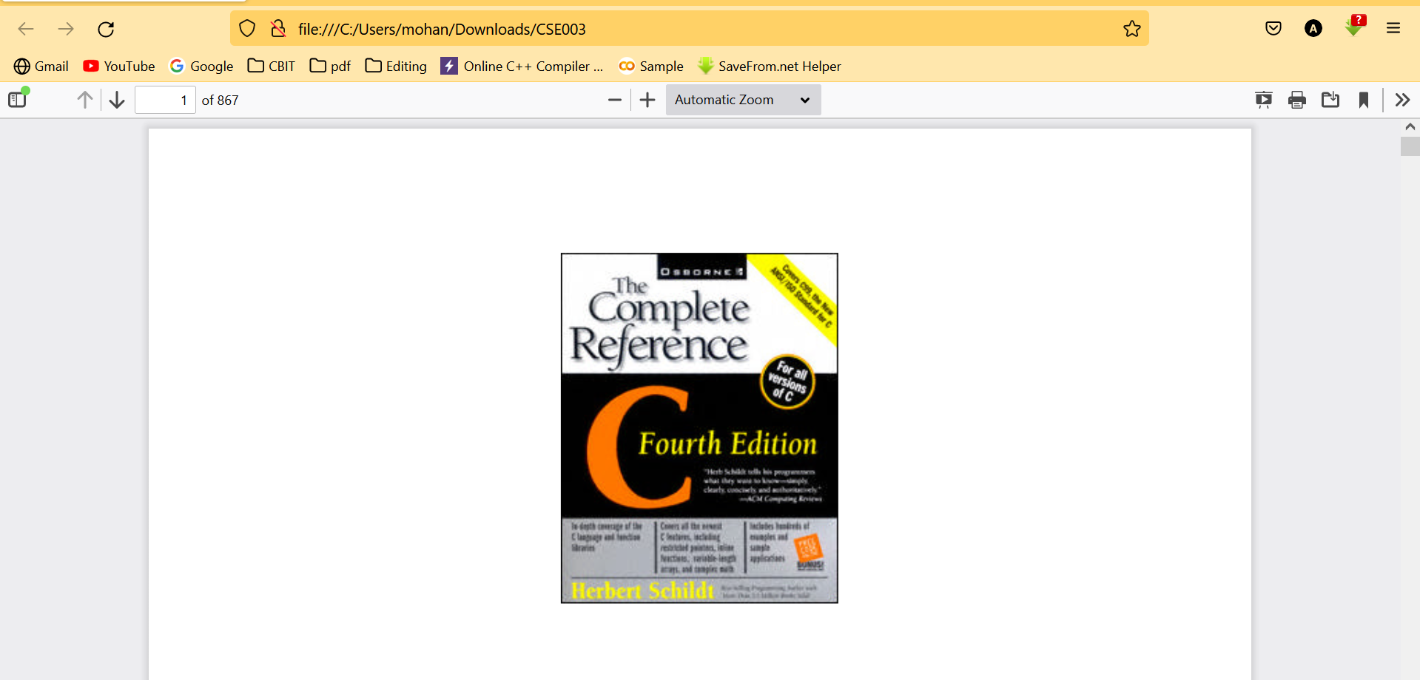
RESULTS

Slide 13
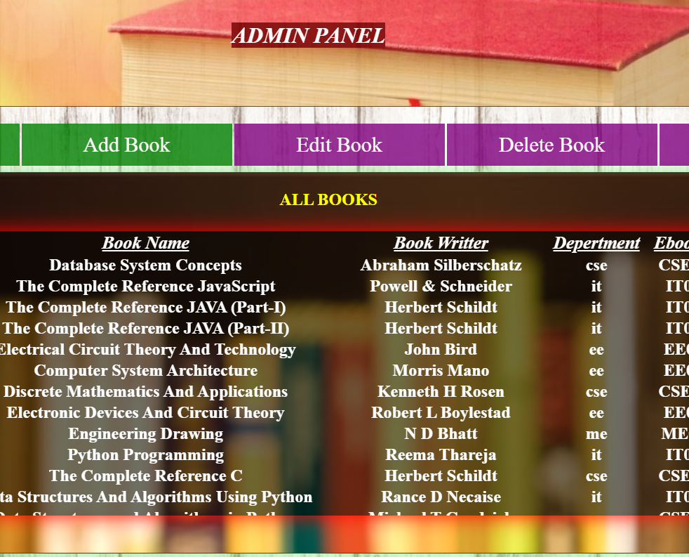
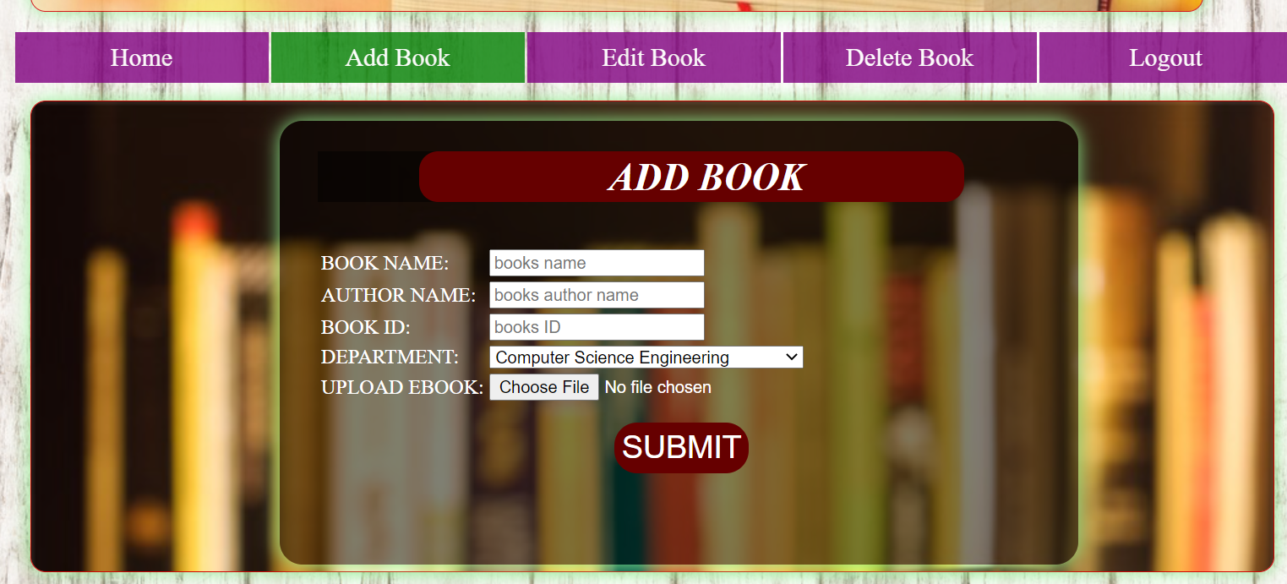
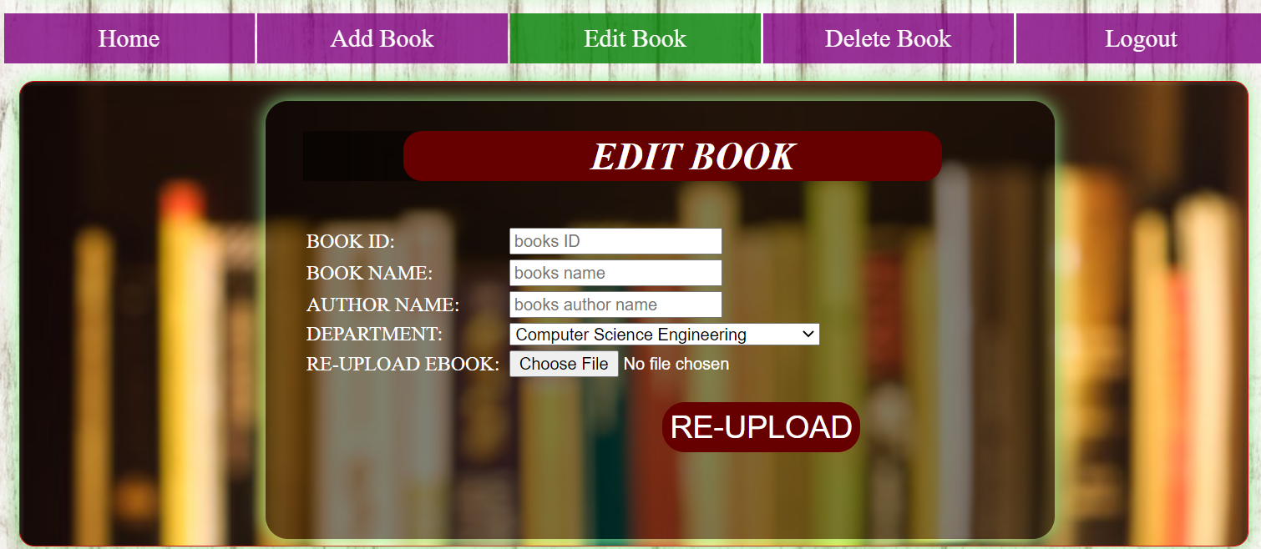
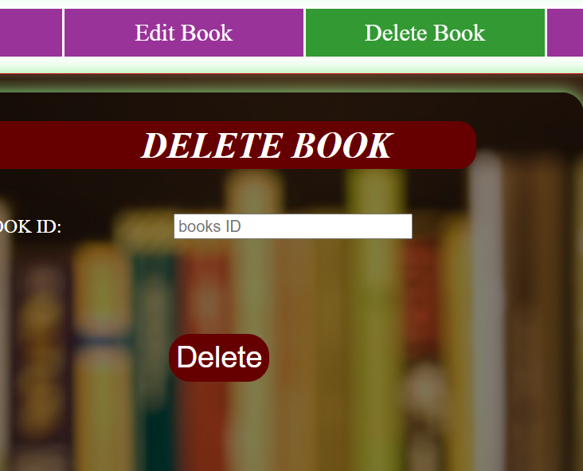
RESULTS ADMIN

Slide 14
SOCIAL IMPLICATIONS
The major social benefits of proposed system includes:
Saves Time : A lot of time is saved whenever a student uses this website.
Less Paper : A lot of paper is reduced if we switch to digital libraries.
Highly Efficient : The proposed system is admin friendly. It provides the reliable search facility for the users.
Secure : The website is completely secure with password constraints present to eliminate the chances of a cyber-attack.
Highly Convenient : The project is highly convenient and easy to use.

Slide 15

FUTURE SCOPE & SETBACKS
Deploy and Host the Website.
Include an Authenticated Login for Admin which is lacking in the current state of project.
Support many other type of files as eBooks.
To accept larger files.
Extend the current project to many other departments.

Slide 16
CONCLUSION
Saves Time: Online library saves a lot of time for the user as he/she needn't visit the library each and every day saving a lot of time and effort.
Highly Convenient: It's very convenient for the user to register and access the books.

Slide 17

Thank You

